Slide 1
CST 205 OOP MODULE 4 EVENT HANDLING-PART 1

Slide 2
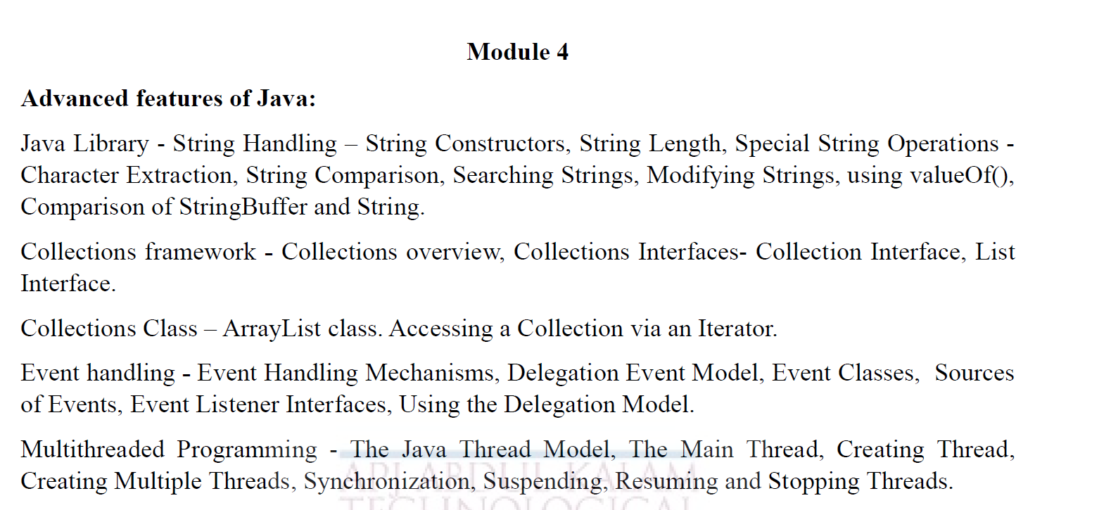

Slide 3
OBJECTIVES
To give an overview Action listeners.
Apply delegation even handling to handle mouse and keyboard events.

Slide 4
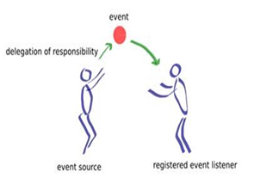
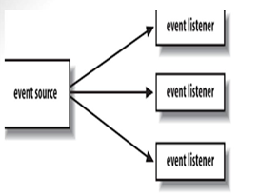
Delegation event handling

Slide 5
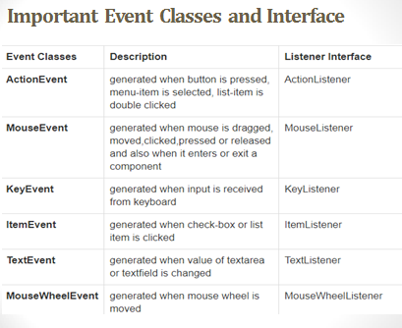

Slide 6
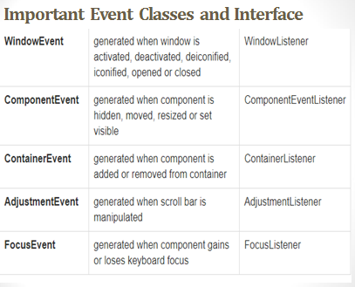

Slide 7
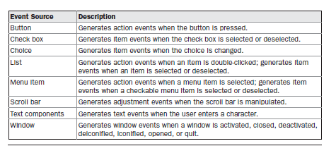
Sources of Events

Slide 8
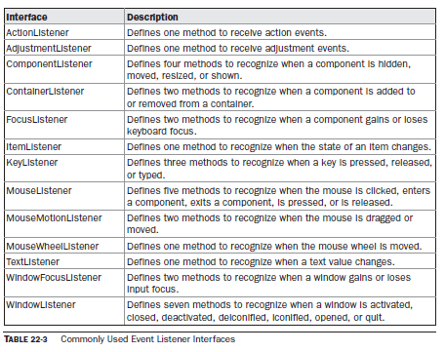
Event Listener Interfaces

Slide 9
Event Listener Interfaces
1. The ActionListener Interface
This interface defines the actionPerformed( ) method that is invoked when an action event occurs.
Its general form is shown here:
void actionPerformed(ActionEvent ae)

Slide 10
Event Listener Interfaces
2.AdjustmentListener
This interface defines the adjustmentValueChanged( ) method that is invoked when an adjustment event occurs.
Its general form is shown here:
void adjustmentValueChanged(AdjustmentEvent ae)
3. The ComponentListener Interface
This interface defines four methods that are invoked when a component is resized, moved, shown, or hidden. Their general forms are shown here:
void componentResized(ComponentEvent ce)
void componentMoved(ComponentEvent ce)
void componentShown(ComponentEvent ce)
void componentHidden(ComponentEvent ce)

Slide 11
Event Listener Interfaces
4. The ContainerListener Interface
This interface contains two methods. When a component is added to a container, componentAdded( ) is invoked.
When a component is removed from container, componentRemoved( ) is invoked.
Their general forms are shown here:
void componentAdded(ContainerEvent ce)
void componentRemoved(ContainerEvent ce)

Slide 12
Event Listener Interfaces
5.The FocusListener Interface
This interface defines two methods. When a component obtains keyboard focus, focusGained( ) is invoked.
When a component loses keyboard focus, focusLost( ) is called.
Their general forms are shown here:
void focusGained(FocusEvent fe)
void focusLost(FocusEvent fe)

Slide 13
Event Listener Interfaces
6. The ItemListener Interface
This interface defines the itemStateChanged( ) method that is invoked when the state of an item changes.
Its general form is shown here:
void itemStateChanged(ItemEvent ie)

Slide 14
Event Listener Interfaces
7. The KeyListener Interface
This interface defines three methods.
The keyPressed( ) and keyReleased( ) methods are invoked when a key is pressed and released, respectively. The keyTyped( ) method is invoked when a character has been entered.
For example, if a user presses and releases the A key, three events are generated in sequence:key pressed, typed, and released.
If a user presses and releases the HOME key, two key events are generated in sequence: key pressed and released.
The general forms of these methods are shown here:
void keyPressed(KeyEvent ke)
void keyReleased(KeyEvent ke)
void keyTyped(KeyEvent ke)

Slide 15
Event Listener Interfaces
8. The MouseListener Interface
This interface defines five methods.
If the mouse is pressed and released at the same point,mouseClicked( ) is invoked.
When the mouse enters a component, the mouseEntered( )method is called.
When it leaves, mouseExited( ) is called.
The mousePressed( ) and mouseReleased( ) methods are invoked when the mouse is pressed and released, respectively.

Slide 16
Event Listener Interfaces
8. The MouseListener Interface
The general forms of these methods are shown here:
void mouseClicked(MouseEvent me)
void mouseEntered(MouseEvent me)
void mouseExited(MouseEvent me)
void mousePressed(MouseEvent me)
void mouseReleased(MouseEvent me)

Slide 17
Event Listener Interfaces
9. The MouseMotionListener Interface
This interface defines two methods.
The mouseDragged( ) method is called multiple times as the mouse is dragged.
The mouseMoved( ) method is called multiple times as the mouse is moved.
Their general forms are shown here:
void mouseDragged(MouseEvent me)
void mouseMoved(MouseEvent me)
10.The MouseWheelListener Interface
This interface defines the mouseWheelMoved( ) method that is invoked when the mouse wheel is moved.
Its general form is shown here:
void mouseWheelMoved(MouseWheelEvent mwe)

Slide 18
Event Listener Interfaces
11.The TextListener Interface
This interface defines the textChanged( ) method that is invoked when a change occurs in a text area or text field.
Its general form is shown here:
void textChanged(TextEvent te)
12. The WindowFocusListener Interface
This interface defines two methods: windowGainedFocus( ) and windowLostFocus( ). These are called when a window gains or loses input focus.
Their general forms are shown here:
void windowGainedFocus(WindowEvent we)
void windowLostFocus(WindowEvent we)

Slide 19
Event Listener Interfaces
13. The WindowListener Interface
This interface defines seven methods. The windowActivated( ) and windowDeactivated( ) methods are invoked when a window is activated or deactivated, respectively.
The general forms of these methods are
void windowActivated(WindowEvent we)
void windowClosed(WindowEvent we)
void windowClosing(WindowEvent we)
void windowDeactivated(WindowEvent we)
void windowDeiconified(WindowEvent we)
void windowIconified(WindowEvent we)
void windowOpened(WindowEvent we)

Slide 20
Using the Delegation Event Model
1. Implement the appropriate interface in the listener so that it will receive the type of event desired.
2. Implement code to register and unregister (if necessary) the listener as a recipient for the event notifications.

Slide 21
Handling Mouse Events
Implement the MouseListener and the MouseMotionListener interfaces.
The MouseEvents class extends Applet and implements both the MouseListener and MouseMotionListener interfaces.
These two interfaces contain methods that receive and process the various types of mouse events.
The applet is both the source and the listener for these events.

Slide 22
Handling Mouse Events
Inside init( ), the applet registers itself as a listener for mouse events.
This is done by using addMouseListener( ) and addMouseMotionListener( ), which, as mentioned, are members of Component.
They are shown here:
void addMouseListener(MouseListener ml)
void addMouseMotionListener(MouseMotionListener mml)

Slide 23
Handling Mouse Events
import java.awt.Frame; import java.awt.Graphics; import java.awt.event.*; public class HandleMouseListenerInWindowExample extends Frame implements MouseListener, MouseMotionListener{ int x=0, y=0; String strEvent = ""; HandleMouseListenerInWindowExample(String title){ //call superclass constructor with window title super(title); | //add mouse listener addMouseListener(this); addMouseMotionListener(this); //set window size setSize(300,300); //show the window setVisible(true); } public void mouseClicked(MouseEvent e) { strEvent = "MouseClicked"; x = e.getX(); y = e.getY(); repaint(); }

Slide 24
Handling Mouse Events
public void mousePressed(MouseEvent e) { strEvent = "MousePressed"; x = e.getX(); y = e.getY(); repaint(); } public void mouseReleased(MouseEvent e) { strEvent = "MouseReleased"; x = e.getX(); y = e.getY(); repaint(); } | public void mouseEntered(MouseEvent e) { strEvent = "MouseEntered"; x = e.getX(); y = e.getY(); repaint(); } public void mouseExited(MouseEvent e) { strEvent = "MouseExited"; x = e.getX(); y = e.getY(); repaint(); }

Slide 25
Handling Mouse Events
public void mouseDragged(MouseEvent e) { x=e.getX(); y=e.getY(); strEvent = "MouseDragged"; repaint(); } public void mouseMoved(MouseEvent e) { x=e.getX(); y=e.getY(); strEvent = "MouseMoved"; repaint(); } | public void paint(Graphics g){ g.drawString(strEvent + " at " + x + "," + y, 50, 50); } public static void main(String[] args) { HandleMouseListenerInWindowExample myWindow = new HandleMouseListenerInWindowExample("Window With Mouse Events Example"); } }

Slide 27
import java.awt.*;
import java.awt.event.*;
public class SampleKey extends Frame implements KeyListener
{
String msg="";
int x=10,y=20;
SampleKey (String title)
{
super(title);
addKeyListener(this); //"this" represent class implementing listener
//here it is Sample key
setSize(300,300);
//show the window
setVisible(true);
}
HANDLING KEYBOARD EVENT

Slide 28
HANDLING KEYBOARD EVENT
public void keyPressed(KeyEvent kevent)
{
msg = "key down";
repaint();
}
public void keyReleased(KeyEvent kevent)
{
msg= "key up";
repaint();
}
public void keyTyped(KeyEvent kevent)
{
msg+=" Pressed character is " + kevent.getKeyChar();
repaint();
}

Slide 29
public void paint(Graphics g)
{
g.drawString(msg + " at " + x + "," + y, 50,50);
}
public static void main(String[] args) {
SampleKey sk = new SampleKey ("Window With Key Events Example");
}
}

Slide 31
CONCLUSION
Delegation Event handling
1.Implement the appropriate interface in the listener so that it will receive the type of event desired.
2. Implement code to register and unregister (if necessary) the listener as a recipient for the event notifications

